Slide 1
Week 7 – Decision Trees and Feature Engineering
Dr. Raj Mani Shukla
PhD, University of Nevada, Reno, USA
Email: raj.shukla@aru.ac.uk
https://raj-shukla.github.io/
https://aru.ac.uk/people/raj-shukla
Content inspiration and slides courtesy: Dr. Arooz Fatima, Dr. Lakshmi Babu -Saheer

Slide 2
Bias Variance Trade-off
Bias | Variance
Simple model/Less training | Complex model/More training
Error in both train and test data | Low error in train data High error in test (unseen) data
Underfitting | Overfitting
Trade off between two is needed. Do not train very less but also not much. Do not use very simple or very complex model

Slide 3
Decision Tree

Slide 4
Decision Trees
Decision Tree algorithm are the supervised learning algorithms.
Decision tree algorithm can be used for solving both regression and classification problems.
Decision Tree creates a model that can use to predict the class or value of the target variable by learning simple decision rules inferred from training data.

Slide 5
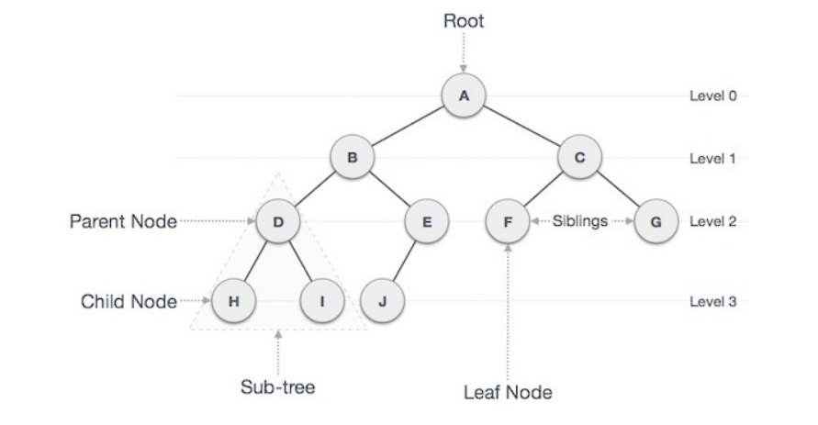
Tree Basics
https://www.tutorialspoint.com/data_structures_algorithms/tree_data_structure.htm

Slide 6
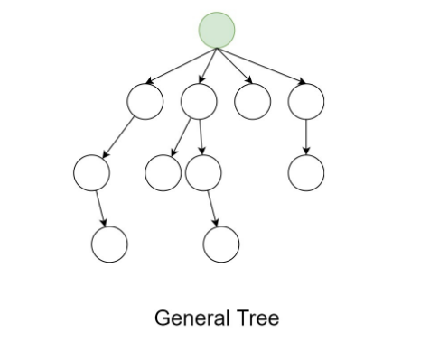
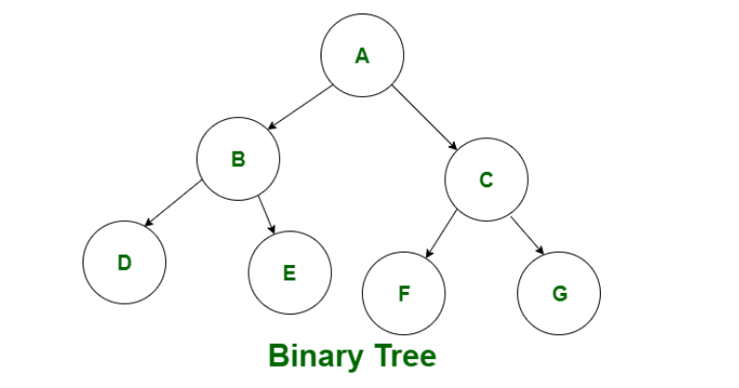
General tree and Binary tree
https://www.geeksforgeeks.org/difference-between-general-tree-and-binary-tree/

Slide 7
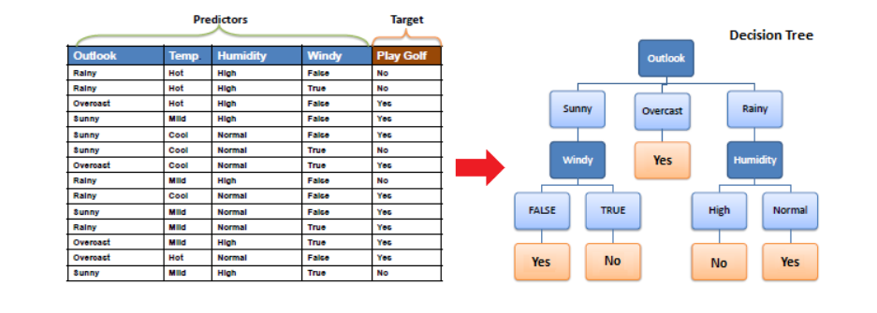
Decision Tree - Intuition
To predict a class label for a record we start from the root of the tree. Then compare the values of the root attribute with the record’s attribute. Correspondingly, we follow the branch corresponding to that value and jump to the next node.

Slide 8
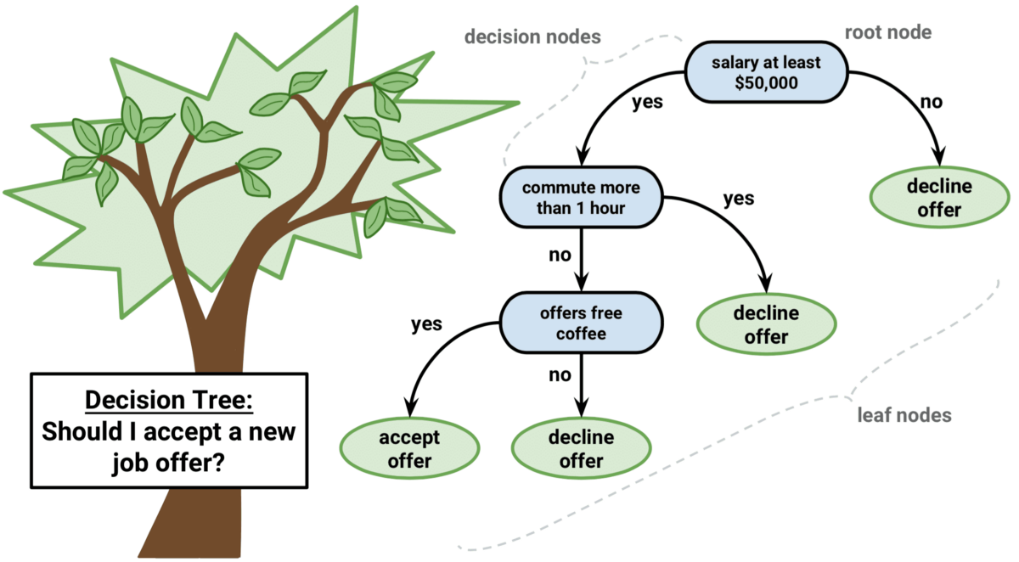
Decision Tree Intuition – Buying a car
https://regenerativetoday.com/simple-explanation-on-how-decision-tree-algorithm-makes-decisions/

Slide 9
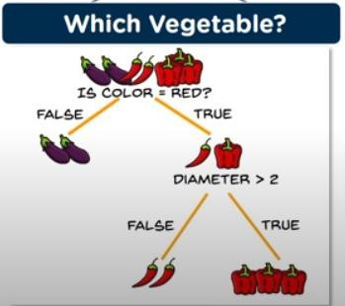
Decision Tree Intuition – Vegetable type

Slide 10
Decision Tree Intuition – Vegetable type
Branch – Decision
Leaf – Outcome/Predictions

Slide 11

Decision Tree: Terminology
https://www.devops.ae/decision-tree-classification-algorithm/

Slide 12
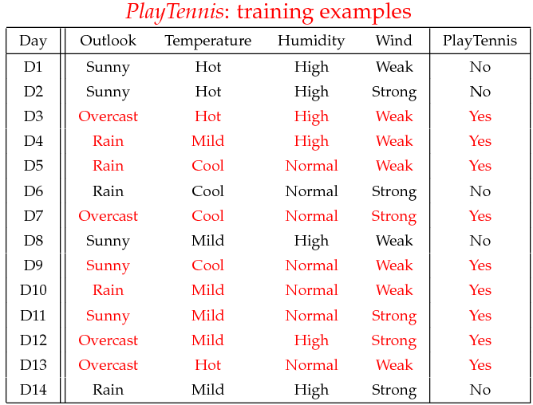
Decision Trees
Does the person play tennis on a given day, given the weather data on that day?

Slide 13
Decision Trees
Output
Features
Does the person play tennis on a given day, given the weather data on that day?
Features?
Binary/Multiclass?
Converting features to numbers?

Slide 14
Decision Trees
Predict whether to play tennis based on temperature, humidity, wind, outlook
Segment data based on features to predict result
Temperature >= Mild
Divides the data into two subsets
Notes:
Decision trees will seek to split up the dataset into 2 datasets, for which the decision is “easier”. And iterate!
The gray node asks a question. Is temperature >= mild?
That question divides the training dataset into 2 sub-datasets.
Hopefully, those two sub-datasets contain more info on the target variable to predict, so that we can say
If temperature < mild, then no tennis
If temperature >= mild, then yes tennis.
The circles where we ask questions are “nodes”,
And the circles where we reach a decision (yes/no) are called “leaves”

Slide 15
Decision Trees
Predict whether to play tennis based on temperature, humidity, wind, outlook
Segment data based on features to predict result
Temperature >= Mild
Humidity = Normal
We can ask more questions
Keep asking questions
Notes:
There is no reason to ask just one question, we can keep asking questions after questions!
The depth of this tree is 2!
A decision tree has categories in the leaves. It is a classification algorithm
However, this idea can be used in predicting quantities instead of classes too
Those are called regression trees.

Slide 16
Building a Decision Trees
Select a Feature and Split
Notes:
Back to decision trees (i.e. classification)
Remember we ask questions, and grow our tree

Slide 17
Decision Trees
do
{
Select a Feature and Split
Continue splitting with available features
}

Slide 18
Decision Trees
do
{
Select a Feature and Split
Continue splitting with available features
}

Slide 19
Decision Trees
do
{
Select a Feature and Split
Continue splitting with available features
}
until (only one class remains OR
a maximum depth is reached OR
a performance metric is achieved
)
Notes:
So when do we stop splitting and declare a decision?
One idea is, until the leaves are pure (remember we’re back to the classification example)
That means, every leaf is a collection of only 1 class. There aren’t any yes/nos in leaves, it’s either fully yes or fully no.
Another idea is we enter a max depth, and stop / prune our tree at that depth.
We don’t allow it to grow any further
As a result, leaves are (probably) not pure! We can make our best guess at that point, whichever class is more dominant in the leaf, we can assign that class to that leaf.
A third idea is, we can keep going until a pre-defined performance metric is achieved.
E.g. if the classification has a certain accuracy, then stop.

Slide 20
Decision Trees - Pseudocode
do
{
Select a Feature and Split
Continue splitting with available features
}
until (only one class remains
OR a maximum depth is reached
OR a performance metric is achieved
)

Slide 21
Decision Trees - Pseudocode
do
{
Select a Feature and Split
Continue splitting with available features
}
until (only one class remains OR a maximum depth is reached OR a performance metric is achieved
)
Any problem in implementing these steps?
Which feature to select at each step?

Slide 22
Building the best decision tree?
Output
Features
Find the best features at step?
Use greedy search: find the best split at each step
What defines the best split?
One that maximizes the information gained from the split
How is information gain defined?
Notes:
So how exactly do we find the right splits? The right question to ask?
We need a way of evaluating all the possible splits
Once we have that way, we can use greedy search to find the best split.
Enter information theory:
We’re going to find the split that induces the biggest “information gain”
But how is that defined mathematically?

Slide 23
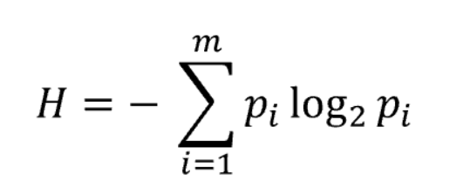

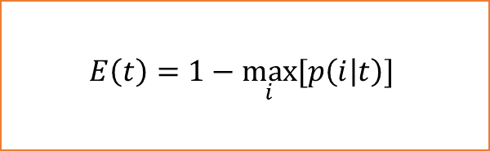
Decision Tree Split Methods
Split based on classification error
$$E\left(t\right)=1−\max_{i}{[p\left(i | t\right)]}$$
Split based on entropy
Split based on gini index

Slide 24
Splitting based
on
Classification Error

Slide 25

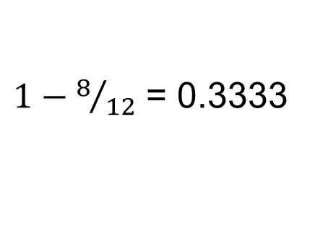
Splitting based on classification error
Classification Error Equation
Temperature >= Mild
Do not play tennis
Do not play tennis
8 Yes
4 No
$$E\left(t\right)=1−\max_{i}{[p\left(i | t\right)]}$$
Classification Error Before
2 Yes
2 No
6 Yes
2 No
$1−8/{12}$ = 0.3333
Notes:
Idea: use accuracy (how often are we right), and look at the classification error
If we classified the above node as YES, we would be right 8 out of 12 times. We would be wrong 4/12, so classification error is = 0.3333
This number cannot be greater than .5 – this is enforced by that max condition in the formula.

Slide 26

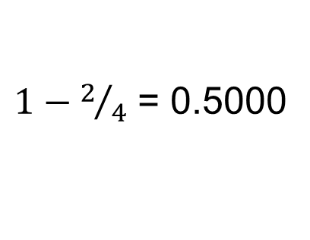
Splitting based on classification error
Temperature >= Mild
Do not play tennis
Do not play tennis
Classification Error Equation
8 Yes
4 No
0.3333
$$E\left(t\right)=1−\max_{i}{[p\left(i | t\right)]}$$
2 Yes
2 No
6 Yes
2 No
Classification Error Left Side
$1−2/4$ = 0.5000
Information lost on
small # of data points
Notes:
So with this split (temperature >= mild), what happened at the sub-nodes?
CE(left) = 0.5
That is some information lost.

Slide 27

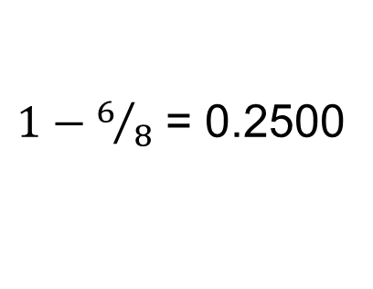
Splitting based on classification error
Splitting based on classification error
Temperature >= Mild
Do not play tennis
Do not play tennis
Classification Error Equation
8 Yes
4 No
0.3333
$$E\left(t\right)=1−\max_{i}{[p\left(i | t\right)]}$$
2 Yes
2 No
6 Yes
2 No
Classification Error Right Side
0.5000
$1−6/8$ = 0.2500
Notes:
CE(right) = 1-6/8 = 0.25 , some info gained.

Slide 28

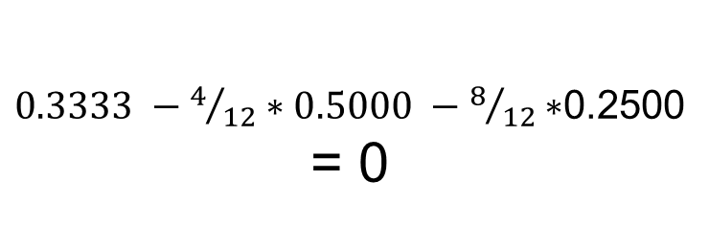
Splitting based on classification error
Temperature >= Mild
Do not play tennis
Do not play tennis
8 Yes
4 No
Classification Error Equation
0.3333
$$E\left(t\right)=1−\max_{i}{[p\left(i | t\right)]}$$
2 Yes
2 No
6 Yes
2 No
Classification Error Change
0.2500
0.5000
$0.3333 −4/{12}∗0.5000 −8/{12}∗$0.2500
= 0
Notes:
What about the total change in info?
Let’s get a weighted average and subtract from the parent node.
Weighted averaging those CE, we get the same CE as the above node! So, in total, no change in classification error!

Slide 29
Splitting based
on
Entropy

Slide 30
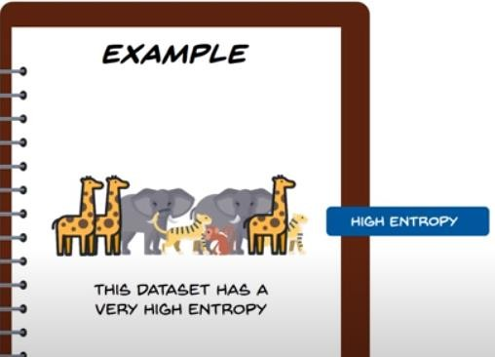
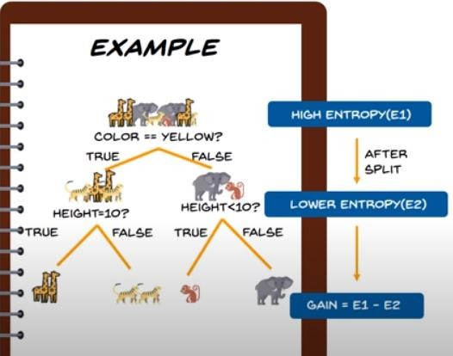
Entropy
It is measure of randomness or unpredictability in the dataset.
how much variance the data has
As we go down
there is a information
gain
High Entropy – Less Information, Low Entropy – More information
Source

Slide 31
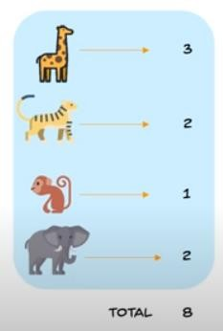
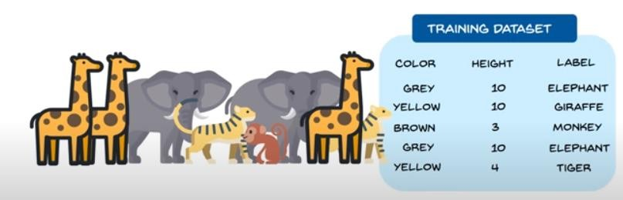
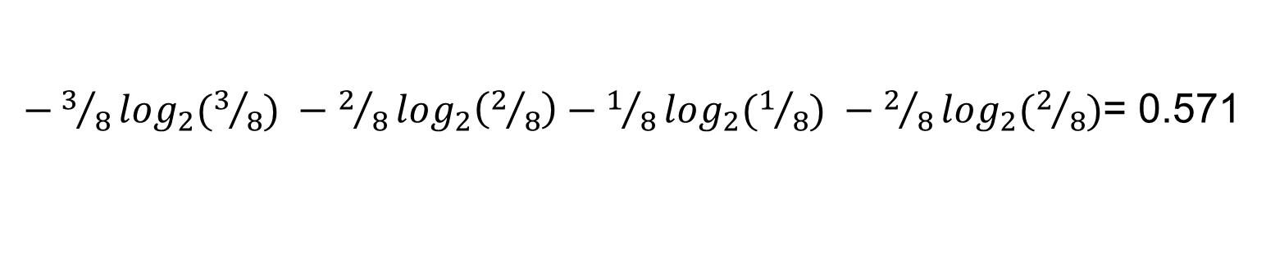
Entropy calculation
$−3/8\log_{2}(3/8) −2/8\log_{2}\left(2/8\right)−1/8\log_{2}(1/8) −2/8\log_{2}(2/8)$= 0.571
Source

Slide 32
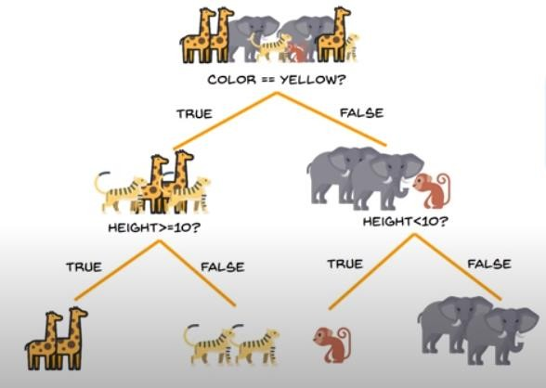
Splitting based on the entropy
In each step, find the criterion that splits the dataset so that decrease in entropy (Information Gain) is maximum

Slide 33
Splitting based
on
Ginni Index

Slide 34

Gini Index
The Gini index is a measure of impurity or uncertainty
If $p_{i}$ is the probability of occurrence of a sample in dataset
Impure dataset
Pure dataset

Slide 35
Splitting based on the entropy
In each step, find the criterion that splits the dataset so that decrease in Gini index (Gini Gain) is maximum

Slide 36
Decision Tree - comments
Do not typically use gradient descent based optimizer.
Greedy search, Tree based search
Typically faster
Outputs are generally explainable

Slide 37
Visualizing Decision tree

Slide 38
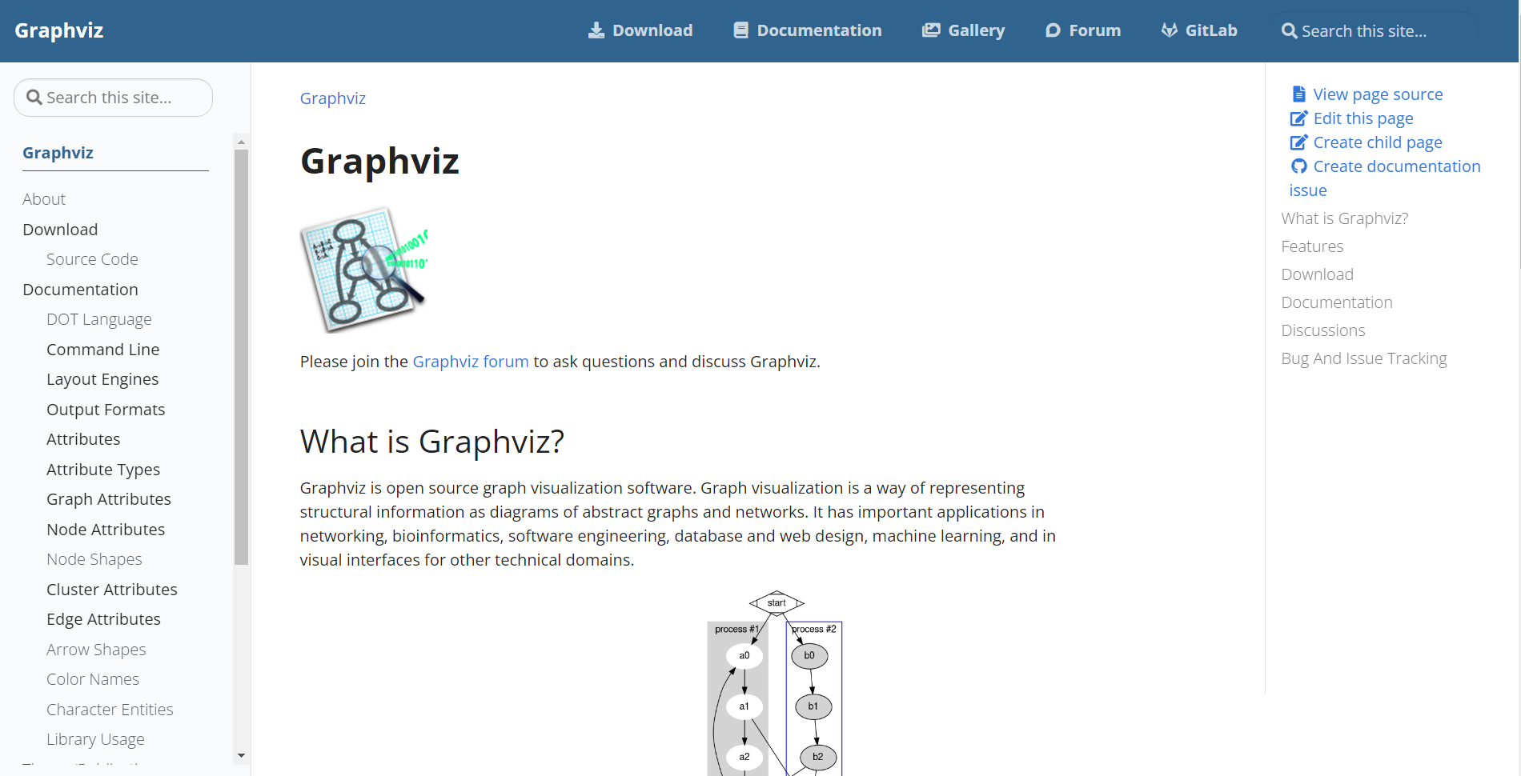

Slide 39
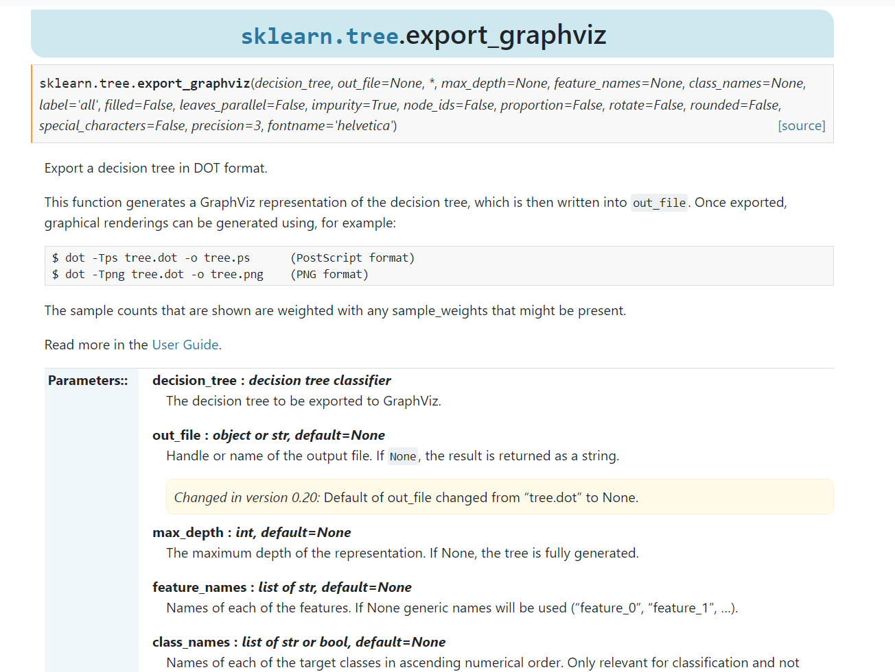
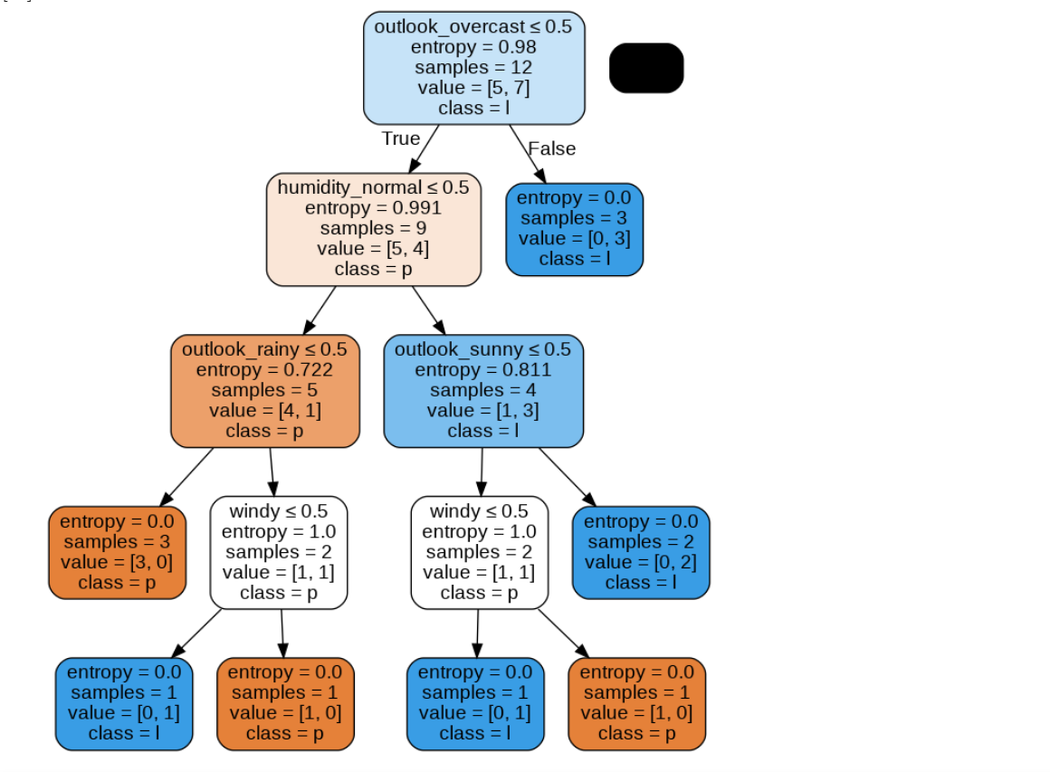
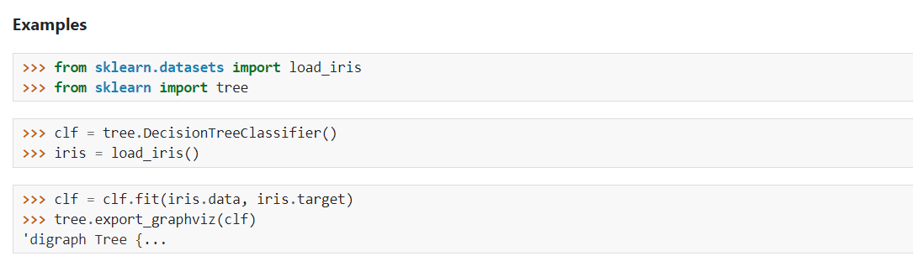

Slide 40
Feature
Selection

Slide 41
Feature selection
What is feature selection?
Why we use feature selection?

Slide 42
What is Feature Selection?
We have some data, and want to use it to build a classifier to predict something
(e.g. student grades, survival rate, likelihood of cancer, etc.)

Slide 43
What is Feature Selection?
We have some data, and want to use it to build a classifier to predict something
(e.g. student grades, survival rate, likelihood of cancer, etc.)
The data has 10,000 columns (features)
We need to cut it down to 1,000 columns before
We try machine learning. Which 1,000?

Slide 44
What is Feature Selection?
We have some data, and want to use it to build a classifier to predict something
(e.g. student grades, survival rate, likelihood of cancer, etc.)
The data has 10,000 columns (features)
We need to cut it down to 1,000 columns before
We try machine learning. Which 1,000?
The process of choosing the 1,000 columns to use is called Feature Selection

Slide 45
Data with many features
Gene expression datasets (~10,000 features)
http://www.ncbi.nlm.nih.gov/sites/entrez?db=gds
Proteomics data (~20,000 features)
http://www.ebi.ac.uk/pride/

Slide 46
Why we do Feature Selection?

Slide 47
Why we do Feature Selection?
http://elpub.scix.net/data/works/att/02-28.content.pdf

Slide 48
Why we do Feature Selection?
Lots more papers, where experiments show that accuracy reduces when you use more features

Slide 49
Why accuracy reduces on increasing features?
Why does accuracy reduce with more features?
How accuracy depend on the choice of features?
What changes if we use more features?
How do we choose the right features?

Slide 50
Why accuracy reduces on increasing features?
Why does accuracy reduce with more features?
How accuracy depend on the choice of features?
What changes if we use more features?
How do we choose the right features?

Slide 51
Noise / Explosion
The additional features typically add noise.
Machine learning will pick up on spurious correlations, that might be true in the training set, but not in the test set.
For some ML methods, more features means more parameters to learn (more NN weights, more decision tree nodes, etc…)
the increased space of possibilities is more difficult to search.

Slide 52
Recursive Feature Elimination: The Syntax
Import the class containing the feature selection method
from sklearn.feature_selection import RFE
Create an instance of the class
rfeMod = RFE(est, n_features_to_select=5)
Fit the instance on the data and then predict the expected value
rfeMod = rfeMod.fit(X_train, y_train)
y_predict = rfeMod.predict(X_test)
The RFECV class will perform feature elimination using cross validation.
est is an instance of the model to use
final number of features
Notes:
RFE stands for recursive feature elimination
RFE is the tool sklearn provides to do feature selection recursively, automatically.
Est can be LASSO. That is a good choice.
And RFE will recursively fit models and drop the least important features at each step
Until it’s left with 5 features.
Those are the most important 5 features.

Slide 53
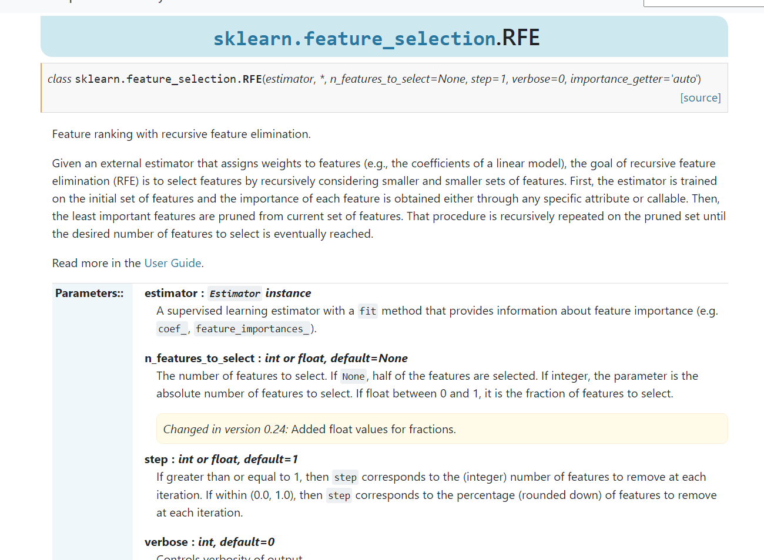
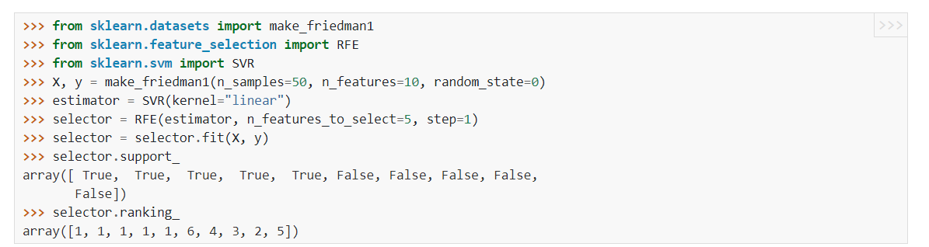

Slide 54
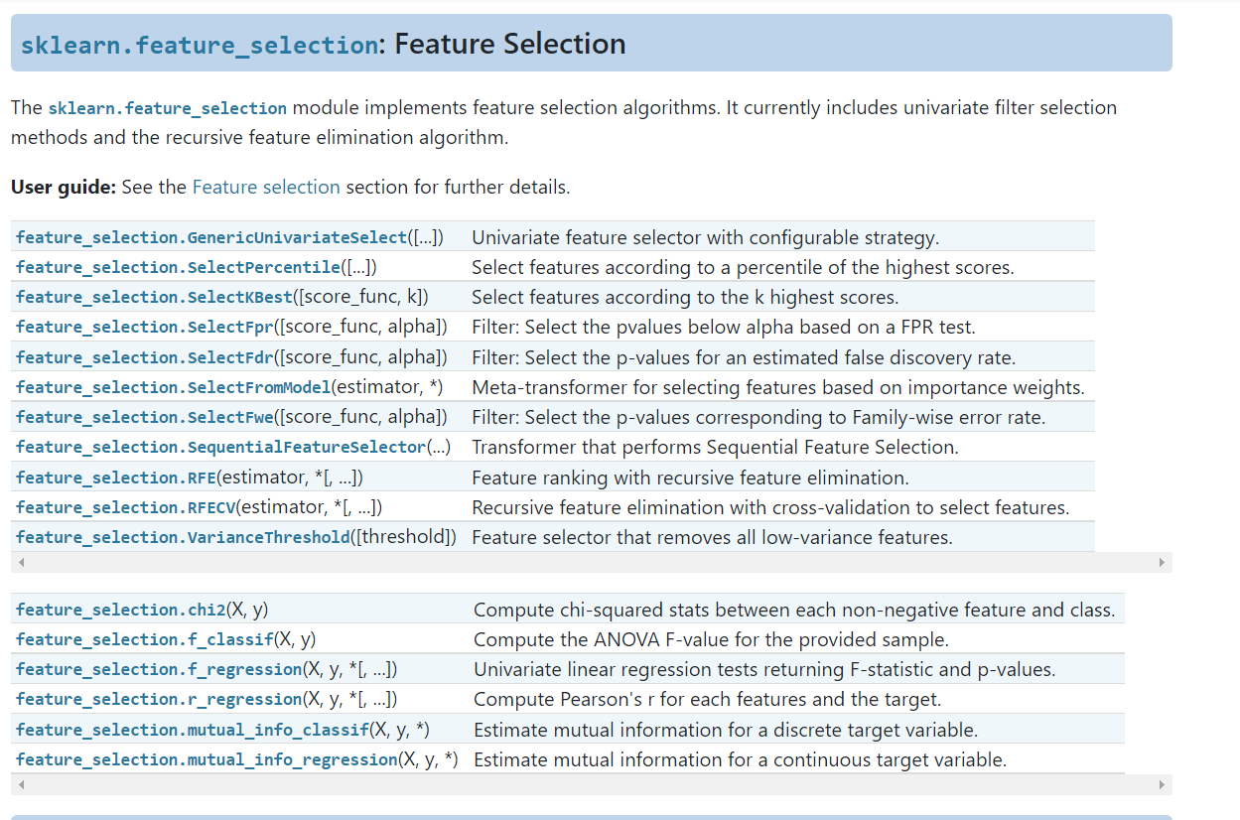

Slide 55
Feature Selection using Principal Component Analysis
Will study in detail later in this module
Some resources:
https://www.youtube.com/watch?v=FD4DeN81ODY&t=341s
https://machinelearningmastery.com/feature-selection-machine-learning-python/

Slide 56
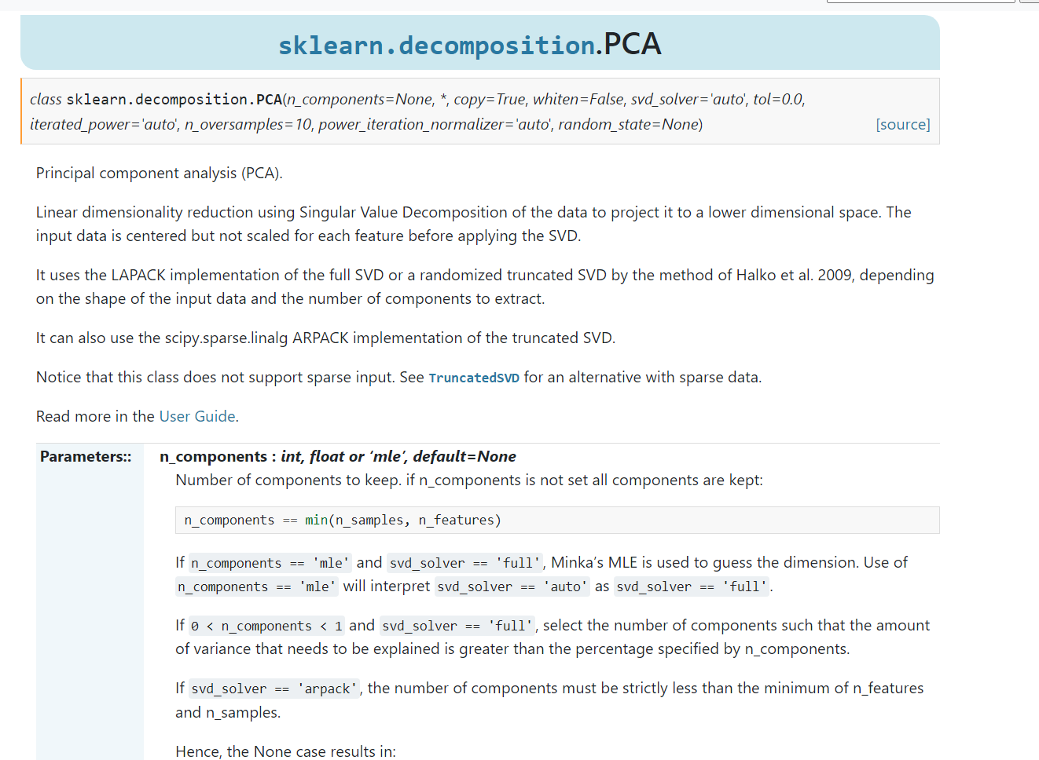
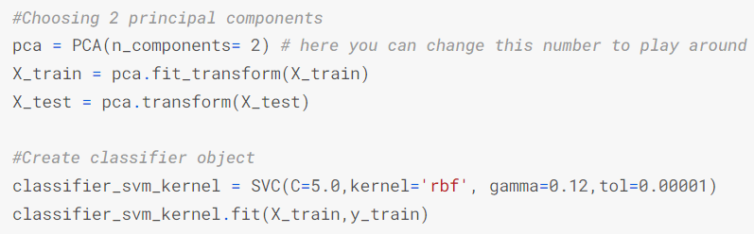
Feature Selection using Principal Component Analysis

